Slide 1
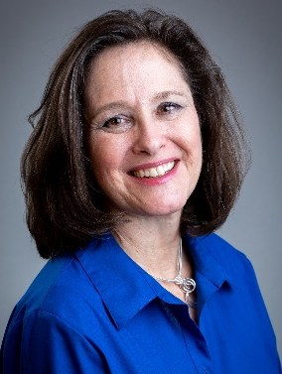
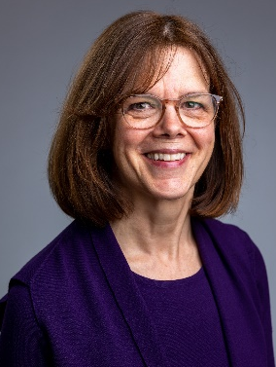
Supporting Your Clients with Cancer
Knoxville Area Psychological Association
September 19, 2022
Denise Stillman, PhD
Program Associate
Debra Sullivan, PhD
Program Director

Slide 2
Presenter Disclosure
“We have no conflicts of interest.”
Denise Stillman, PhD
Debra Sullivan, PhD
Cancer Support Community East Tennessee

Slide 3
Learning Objectives
Name at least 3 symptoms of depression that may be unreliable indicators of depression during cancer treatments
Identify at least 3 Cognitive-Behavioral interventions that help improve quality of life when living with or through cancer treatments
Describe 2 or more sources of meaning according to Meaning-Centered Psychotherapy for cancer patients

Slide 4
Cancer Overview
What is cancer?
A disease in which some of the body’s cells grow uncontrollably and spread to other parts of the body. (National Cancer Institute, www.cancer.gov)
How prevalent is cancer?
1.8 million new cases of cancer diagnosed in the United States in 2020
Breast, lung, prostate, and colon are most common
17 million Americans are currently 5-year cancer survivors. This is estimated to grow to 22.2 million by 2030.

Slide 5
Cancer Overview
Who gets cancer?
91% of cancers occur in adults 45 and older.
Age Category | Share of All Cancer Type Diagnoses in the US (%)
Under 20 | 1%
20 - 34 | 3%
35 - 44 | 5%
45 - 54 | 14%
55 - 64 | 24%
65 - 74 | 25%
75 - 84 | 20%
85+ | 8%

Slide 6
Cancer Overview
Treatments for Cancer
Chemotherapy
Hormone therapy
Immunotherapy
Radiation
Surgery
Targeted therapy

Slide 7
Cancer Trajectory
Diagnosis
Treatment induction or prior to major surgery
Treatment side effects
Termination of treatment
Normalization
Recurrence or metastases
End of life

Slide 8
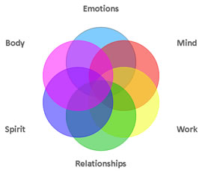
Stating the Obvious
A cancer diagnosis is challenging
It affects every area of one’s life
It affects all relationships
with self
with loved ones
with family
with friends
with coworkers

Slide 9
Co-Morbid Psychological Conditions: Depression
Approximately 13% of cancer patients meet criteria for Major Depressive Disorder, as measured by a structured interview – about twice the prevalence in a non-cancer population.
Depression is highest in the acute phase of treatment, and for patients in palliative care.

Slide 10
Co-Morbid Psychological Conditions: Anxiety
Prevalence of anxiety in cancer patients has been studied less than depression and has relied more heavily on self-report. Rates range from 18% to 26%.
Younger patients, under 39, tend to have more anxiety, as compared to the normal population, than older cancer patients. This especially holds true after 5 years survival.

Slide 11
Co-Morbid Psychological Conditions: Post Traumatic
Stress Disorder (PTSD)
PTSD can be diagnosed in cancer patients, according to the DSM-V, if the cancer diagnosis or treatment is associated with a circumscribed traumatic, life-threatening event.
The prevalence of PTSD in a cancer population is statistically not higher than in the general population – about 5%.
Early traumatic experiences can predispose patients to PTSD reactions during cancer.

Slide 12
Diagnostic Considerations
Side effects of cancer treatment
overlap with symptoms of
depression and anxiety
Unreliable Symptoms
fatigue, sleep disturbance, eating disturbances, poor concentration Reliable Symptoms persistent depressed or angry mood, lack of pleasure in
activities, excessive worry for a prolonged period of
time, feelings of guilt, suicidal ideation, hopelessness

Slide 13
Common Clinical Issues
Existential distress – loss of meaning/purpose
Fear of recurrence or death
Grief
Loss of control
Loss of hope
Uncertainty
Unwanted aloneness

Slide 14
Common Clinical Issues (Cont.)
Not all clinical issues are in the negative direction.
Action on important life decisions
Gratitude
Greater present moment awareness
Increased or renewed sense of purpose/meaning
Post-traumatic growth

Slide 15
Cognitive-Behavioral Interventions
Finding and maintaining healthy social support through the cancer experience is vital for emotional and physical health.
Dr. Lorenzo Cohen, clinical director of Integrative Medicine at MD Anderson Cancer Center in Texas and co-author of Anti-Cancer Living, names social support at the top of his list of 6 components of anti-cancer living. (The remaining five are managing stress, getting good sleep, incorporating gentle movement and health-conscious nutrition into everyday life, and limiting environmental exposure to a multitude of carcinogens.)

Slide 16
Cognitive-Behavioral Interventions
Adequate social support and having a sense of community can
decrease feelings of isolation
reduce depression and anxiety
improve compliance with treatment and
self-care
increase personal empowerment
Notes:
community

Slide 17
Cognitive-Behavioral Interventions
Self-calming strategies are helpful in managing anxiety, coping with aversive medical procedures, sleep problems, and cancer-related pain.
Deep breathing exercises
Meditation
Progressive muscle relaxation
Having several strategies at one’s disposal is ideal. If one is not possible or helpful, another one may be.
Notes:
Self-calming

Slide 18
Cognitive-Behavioral Interventions
Healthy self-care such as
Sleep
Nutrition
Gentle Movement: exercise, yoga/qigong
Healthy habits can:
increase a sense of control by targeting what is controllable
help put the body in the best position to tolerate treatment and fight the cancer
facilitate personal empowerment

Slide 19
Cognitive-Behavioral Interventions
Maintain productive and pleasurable activity that fit within one’s physical and emotional capacity.
Develop awareness of what one can and can no longer do
Discuss goals and limitations with loved ones
Take the trip (but purchase the trip insurance)
Consider “legacy” activities to connect to one’s roots and other generations and increase meaning/purpose
Notes:
activity

Slide 20
Cognitive-Behavioral Interventions
Managing negative or catastrophic thinking is especially important – and nuanced – when there is so much uncertainty.
It can help in the clinical setting to:
normalize catastrophic thinking through psychoeducation
explore pre-existing patterns of worry that may be adding to one’s distress
focus on mindfulness-based strategies that encourage living fully and well with negative thoughts present
Notes:
negativity

Slide 21
Cognitive-Behavioral Interventions
Cultivating acceptance amid challenge.
Facilitates present-moment awareness
Mindful awareness of pain and distress teaches what really matters
Increases the possibility of finding beauty, joy, humor, moments of peace, and connection
Notes:
acceptance

Slide 22
Cognitive-Behavioral Interventions
Cultivating acceptance amid challenge.
Mindfulness-Based Stress Reduction (MBSR)
Dr. Linda Carlson’s Mindfulness-Based Cancer Recovery (MBCR)
Notes:
acceptance

Slide 23
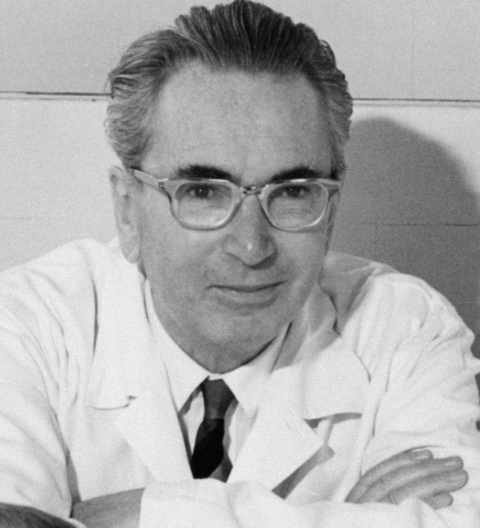
Meaning Centered Psychotherapy
Memorial Sloan Kettering Cancer Center
Inspired by the work of
Viktor Frankl (1905–1997)
Structured, manualized,
brief psychotherapy
Active ingredient is in
enhanced meaning
Improved quality of life,
significantly less anxiety,
depression & hopelessness

Slide 24
Meaning Centered Psychotherapy: Basic Concepts
Will to Meaning: The desire to find meaning in human existence is a basic motivation for human behavior.

Slide 25
Meaning Centered Psychotherapy: Basic Concepts
Life Has Meaning: The possibility to create or experience meaning exists throughout our lives, even up to the last moments of life. If we feel life is meaningless, it is not because there is no meaning in our lives, it is because we have become disconnected from meaning.

Slide 26
Meaning Centered Psychotherapy: Basic Concepts
Freedom of Will: We have the freedom to find meaning in our existence and to choose our attitude toward suffering and limitations.

Slide 27
Meaning Centered Psychotherapy: Basic Concepts
“What matters is never a technique per se, but rather the spirit in which the technique is used.”
-Viktor Frankl

Slide 28
Sources of Meaning: Experiential
“Connecting with Life”
nature, art, relationships, love, humor
Question/Reflection
List 3 ways in which you “connect with life” and feel most alive through the experiential sources of love, beauty, humor.

Slide 29
Sources of Meaning:
Creative
“Actively Engaging in Life”
roles, work deeds, causes, accomplishments
Requires: courage, commitment, responsibility
Question/Reflection
Do you feel you have expressed what’s most meaningful to you through your life’s work and creative activities (e.g. job, parenting, hobbies, causes)? If so, how?

Slide 30
Sources of Meaning:
Attitudinal
“Encountering Life’s Limitations”
the attitude taken towards given circumstances: physical suffering, personal adversity, one’s mortality, and uncertain future
Question/Reflection
Since your diagnosis, what are the specific limitations or losses you’ve faced and how are you coping or dealing with them now? Are you still able to find meaning in your daily life despite your awareness of the limitations and finiteness of life?

Slide 31
Sources of Meaning:
Historical
“Life as a Living Legacy”
Legacy that has been given (past), Legacy that one lives (present), Legacy that one will give (future)
Question/Reflection
As you reflect upon who you are today, what are the meaningful activities, roles, or accomplishments that you’re most proud of? As you look toward the future, what are some of the life lessons you’ve learned along the way and values you may feel are important that you would want to pass on to others?

Slide 32
Additional Thoughts on Supporting Clients with Cancer
The cancer experience is often a physical, emotional, and sometimes spiritual rollercoaster. It is helpful to have someone helping to smooth out the ride.
Many interventions are helpful and client preference matters, so helping clients find what works best for them along the way can be extremely beneficial.

Slide 33
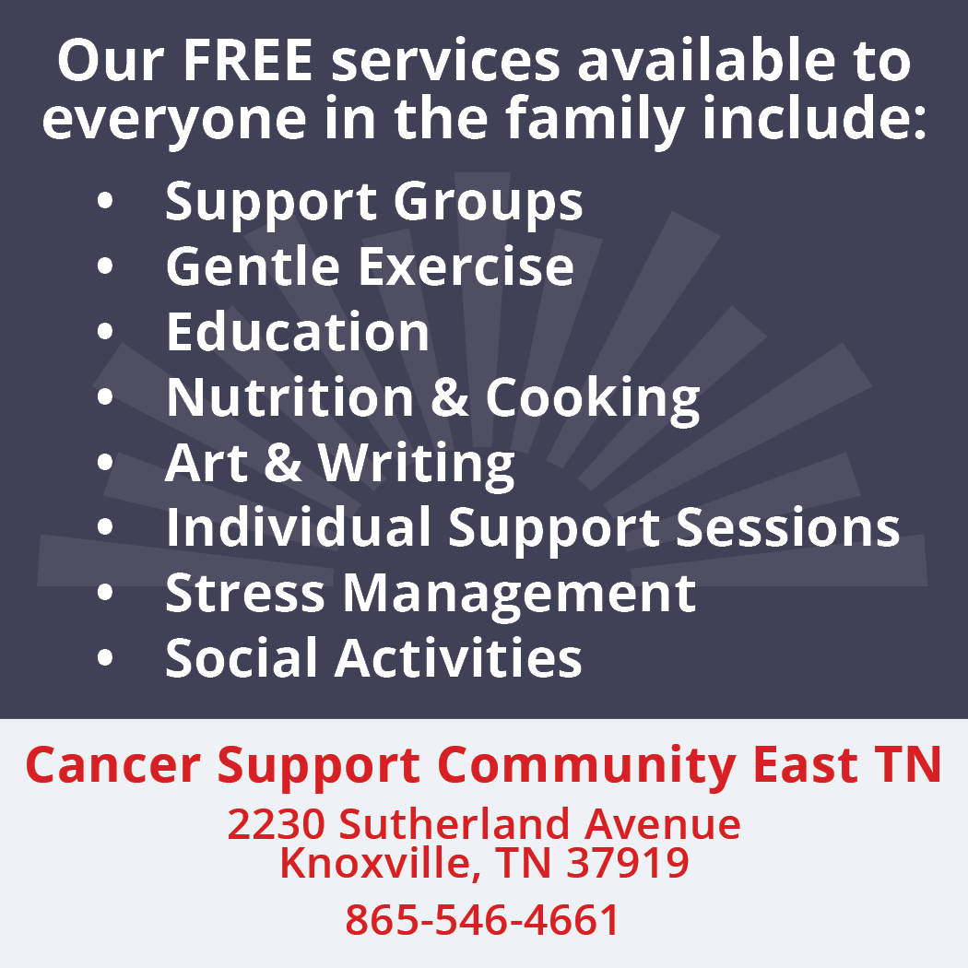

Slide 35
“Independent of any disease state, healing is possible for anyone and everyone.”
-Dr. Rachel Naomi Remen

Slide 36
References
Breitbart, W. (Ed). (2017). Meaning-centered psychotherapy in the cancer setting: Finding meaning and hope in the face of suffering. Oxford University Press
Breitbart, W., Pessin, H., Rosenfeld, Barry, et al (2018) Individual Meaning-Centered Psychotherapy for the Treatment of Psychological and Existential Distress: A Randomized Controlled Trial in Patients With Advanced Cancer. Cancer.
Carlson, L. M. (2011) Mindfulness Based Cancer Recovery: A Step-by-Step MBSR Approach to Help You Cope with Treatment and Reclaim Your Life.
Carlson, L.E. (2018). Distress Management through Mind-Body Therapies in Oncology. Journal of the National Cancer Institute.
Cohen, L. & Jefferies, A. (2018) Anti- Cancer Living: Transform Your Life and Healt2011) Mindfulness Based Cancer Recovery: A Step-by-Step MBSR Approach to Help You Cope with Treatment and Reclaim Your Life.
National Cancer Institute, www.cancer.gov

